Slide 1
Expected goals - xG
Football statistics

Slide 2
What is xG?
Each shot is assigned an xG value
A probability that the shot will go in based on ‘similar’ shots in the past
By summing up all the xG values for a team within a game you get a performance indicator
A team that has been able to create a lot of ‘clear cut’ chances has played well (or the other team has played badly)
Different models take into account different features
Main features are…
Distance
Angle from goal
Type of assist
Header/ foot
Notes:
Define similar in a sec
Perf indicator like goals or shots
In reality hard to know what people use - secret
Opta also define BIG CHANCES

Slide 3
Why use xG?
It is a performance indicator that has less noise than other indicators such as goals or shots
A team can play badly and score more/ the same amount of goals
Barcelona vs. Chelsea 2011/2012 season
23 shots vs. 7

Slide 4
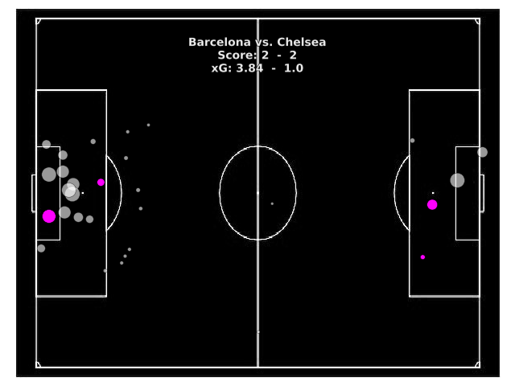
*Doesn’t include penalty
Notes:
Introduce xG map - Size of bubble is probability
Had to get the data from elsewhere because of age
Very very rough shot map – doesn’t include penalty
John Terry sent off – looking like the game was lost and Ramires produces the most beautiful chip Ive ever seen!

Slide 5
Why use xG?
It is a performance indicator that has less noise than other indicators such as goals or shots
A team can play badly and score more/ the same amount of goals
Barcelona vs. Chelsea 2011/2012 season
23 shots vs. 7
A team can have lots of shots but they may all be of poor quality
Liverpool vs. Chelsea 2013/14 season
26 shots vs. 11
Gerrard had 9 shots
Notes:
Then people started looking at shots as a measure...

Slide 6
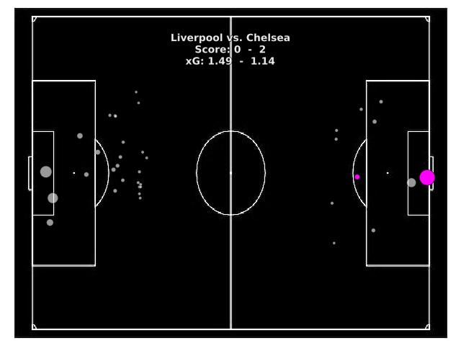
Notes:
Liverpool’s 26 shots compared to Chelsea’s 7

Slide 7
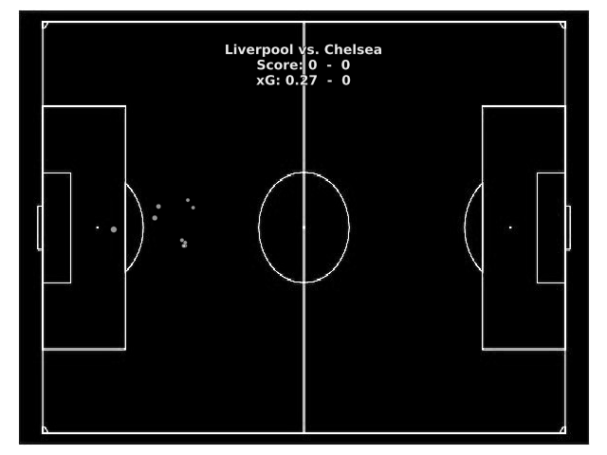
Notes:
Steven Gerrard’s shot map – 9 ‘poor’ shots
Only one of these in the first half

Slide 8
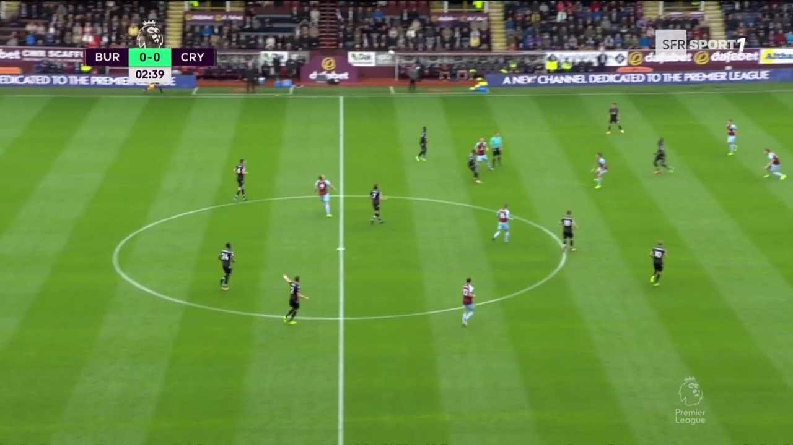
Limitations of xG
xG = 0.02

Slide 9
Limitations of xG
Player positioning
Teams are now signing up for GPS data so will start seeing more models based on this
Fernando, T., Wei, X., Fookes, C., Sridharan, S. and Lucey, P., 2015. Discovering methods of scoring in soccer using tracking data. Large-Scale Sports Analytics, Sidney.
StrataBet don’t use GPS but do log the number of players between the ball and the goal
Some teams/players finish better than others
In particular there are differences in finishing between different leagues
Sample size for players isn’t really large enough to get individual predictions
Include wages/ valuation of players
You’d obviously expect Harry Kane to finish better than Gary Cahill
My model in particular takes into account penalties as well
The football community doesn’t particularly like stats
Notes:
gps
I have stolen these stats…
In the 2014 season - in the NHL, Alexander Ovechkin attempted 795 shots. In the NBA, Stephen Curry tossed up 1341.
Over the last 6 years combined, Ronaldo was the only player to attempt 1000 non penalty shots. Messi ~ 950. Zlatan ~ 750.

Slide 10
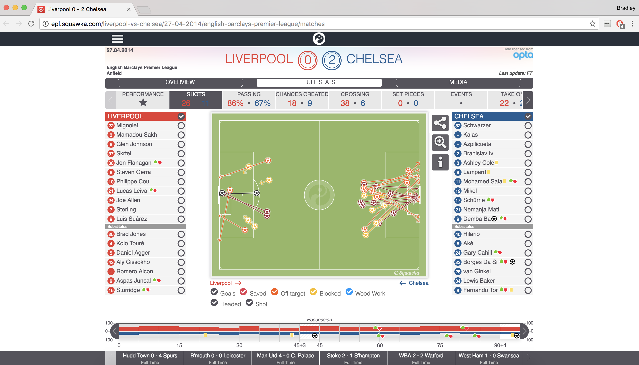
Method
Scraped data from Squawka using Selenium
For each shot
x coordinate
y coordinate
header/ no header
Logistic regression
sklearn
“Neural network”
Notes:
Neural network is used lightly because if someone actually looked at the code there’s a chance they’d tell me it isn’t a neural network at all
This is how we get xG. Now need to calculate team ratings to calculate probabilities of matches

Slide 11
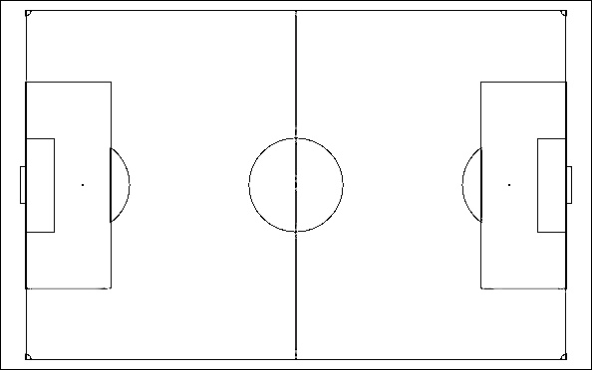
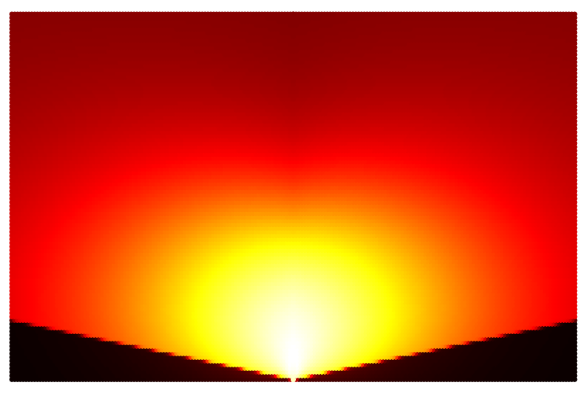
Heatmap

Slide 12
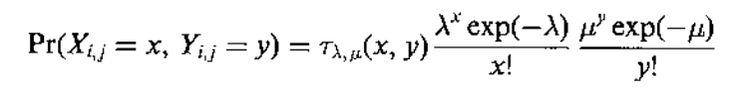
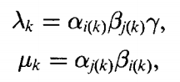
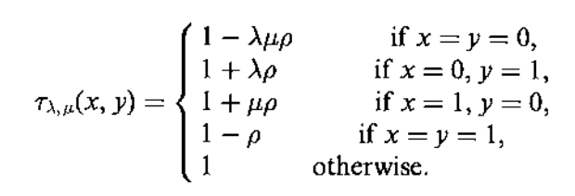
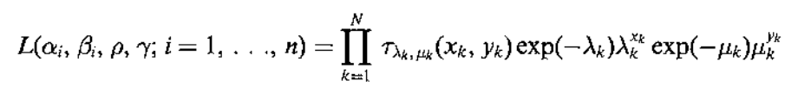
Team ratings – define more explicitly what the greek letters are
Get team ratings for the previous season – 0.8 xG and 0.2 FTG
Dixon, M.J. and Coles, S.G., 1997. Modelling association football scores and inefficiencies in the football betting market. Journal of the Royal Statistical Society: Series C (Applied Statistics), 46(2), pp.265-280.
Team ratings are linearly related to (0.8 xG + 0.2 FTG) so can predict current seasons
Maher, M.J., 1982. Modelling association football scores. Statistica Neerlandica, 36(3), pp.109-118.
Notes:
Split ratings into Home Attack, Home Defense, Away Attack and Away Defense but I got rid of the gamma and had home and away ratings instead (based on another paper) – in hindsight, as you’ll see, bad idea. RHO is dependence between home and away scores. I just set this at about 0.15
Modified bivariate Poisson distribution
Dixon and Coles now both run competing sports statistic firms. Apparently they now hate each other
I realize a linear regression probably isn’t the best way to do it and assume that theres a reason the likelihhod led to that but there you go

Slide 13
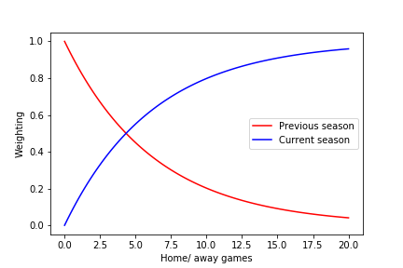
Team ratings
Combine the two ratings using an exponential decay
Currently at the end of GW8
so ~ 50-50
The issue at the beginning of the season is
quality of opponent
Notes:
The reason I’ve set the exponential factor at ~ 0.16 is…
1. it is divisible by 8 and 8 is my favourite number
2. Because home and away ratings are done separately you have to wait a decent length of time to ensure teams have played a varied level of competition
If anyone has a better way to do this I’d love to hear it

Slide 14




Top 4 - opponents so far
Man United - 10
Man City - 11
Tottenham - 12
Chelsea - 9
Man City - 11
Average 16-17 league position of opponents
Notes:
If you use the opponents league positions this season you get bigger differences but run into the same sort of issues
One again, if anyone has a solution please tell me

Slide 15
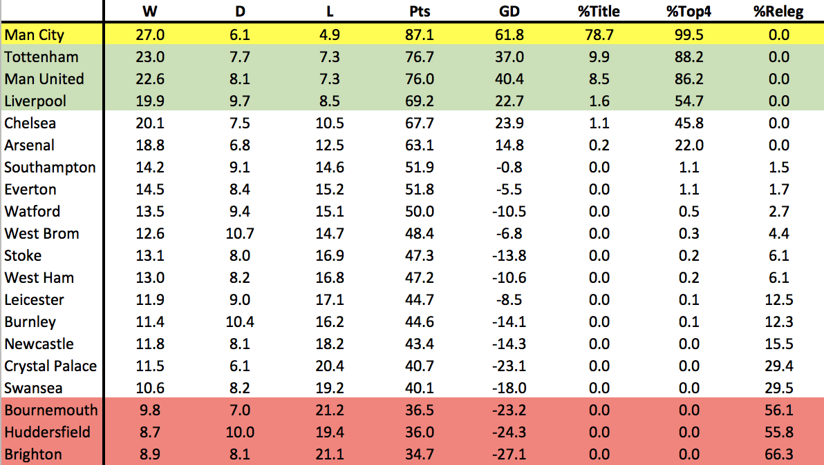
Current predictions – end of GW8
Notes:
Run it 10000 times and take an average
Recently managed to get it running across 4 cores so it takes about 2.5 mins
Will try and get it to do a million in this time

Slide 16
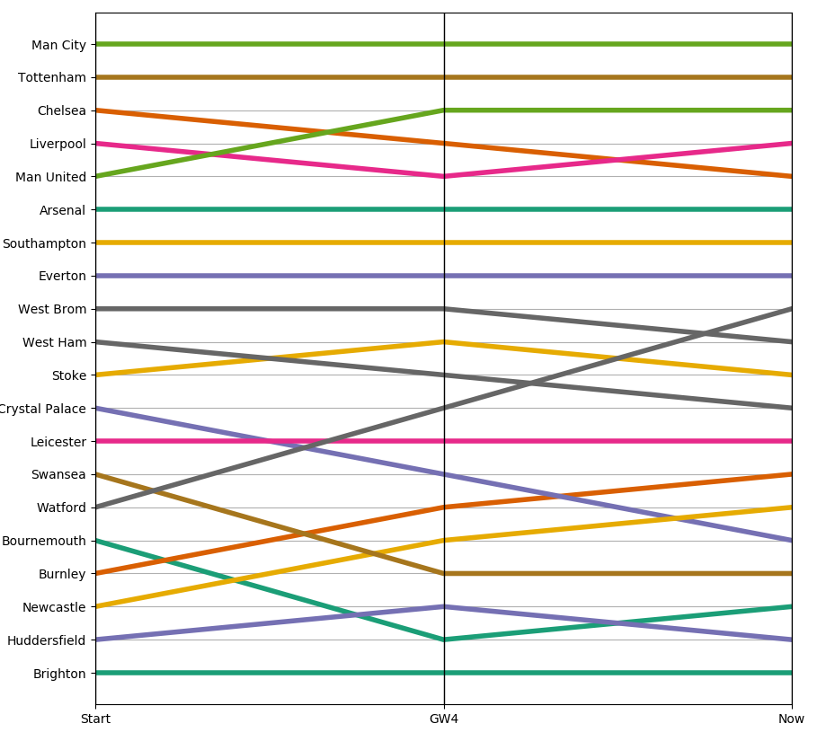
How the predictions have changed

Slide 17
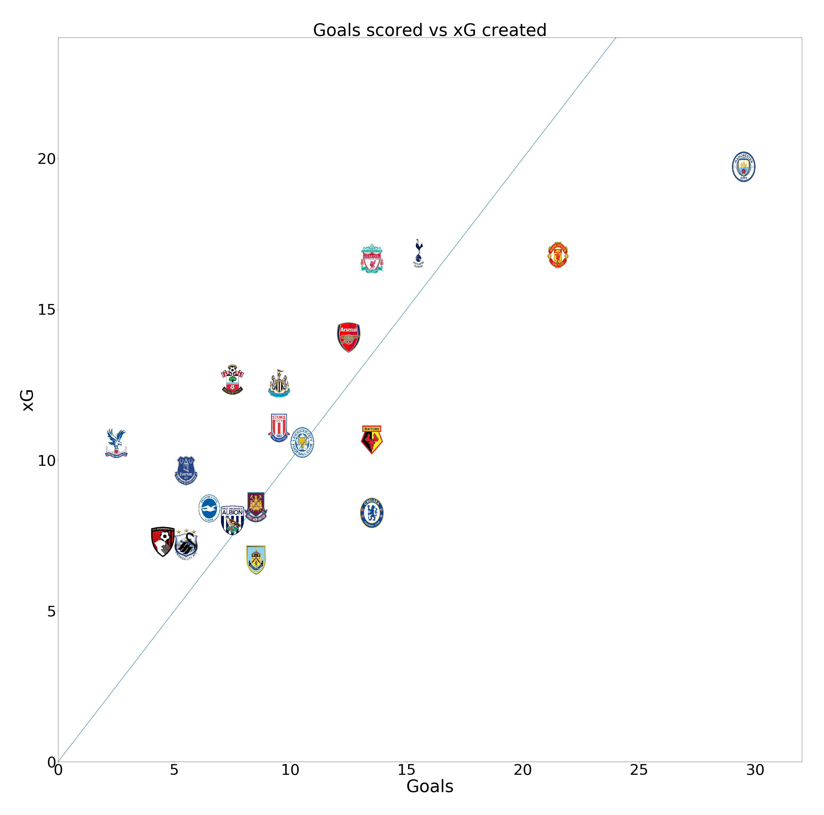
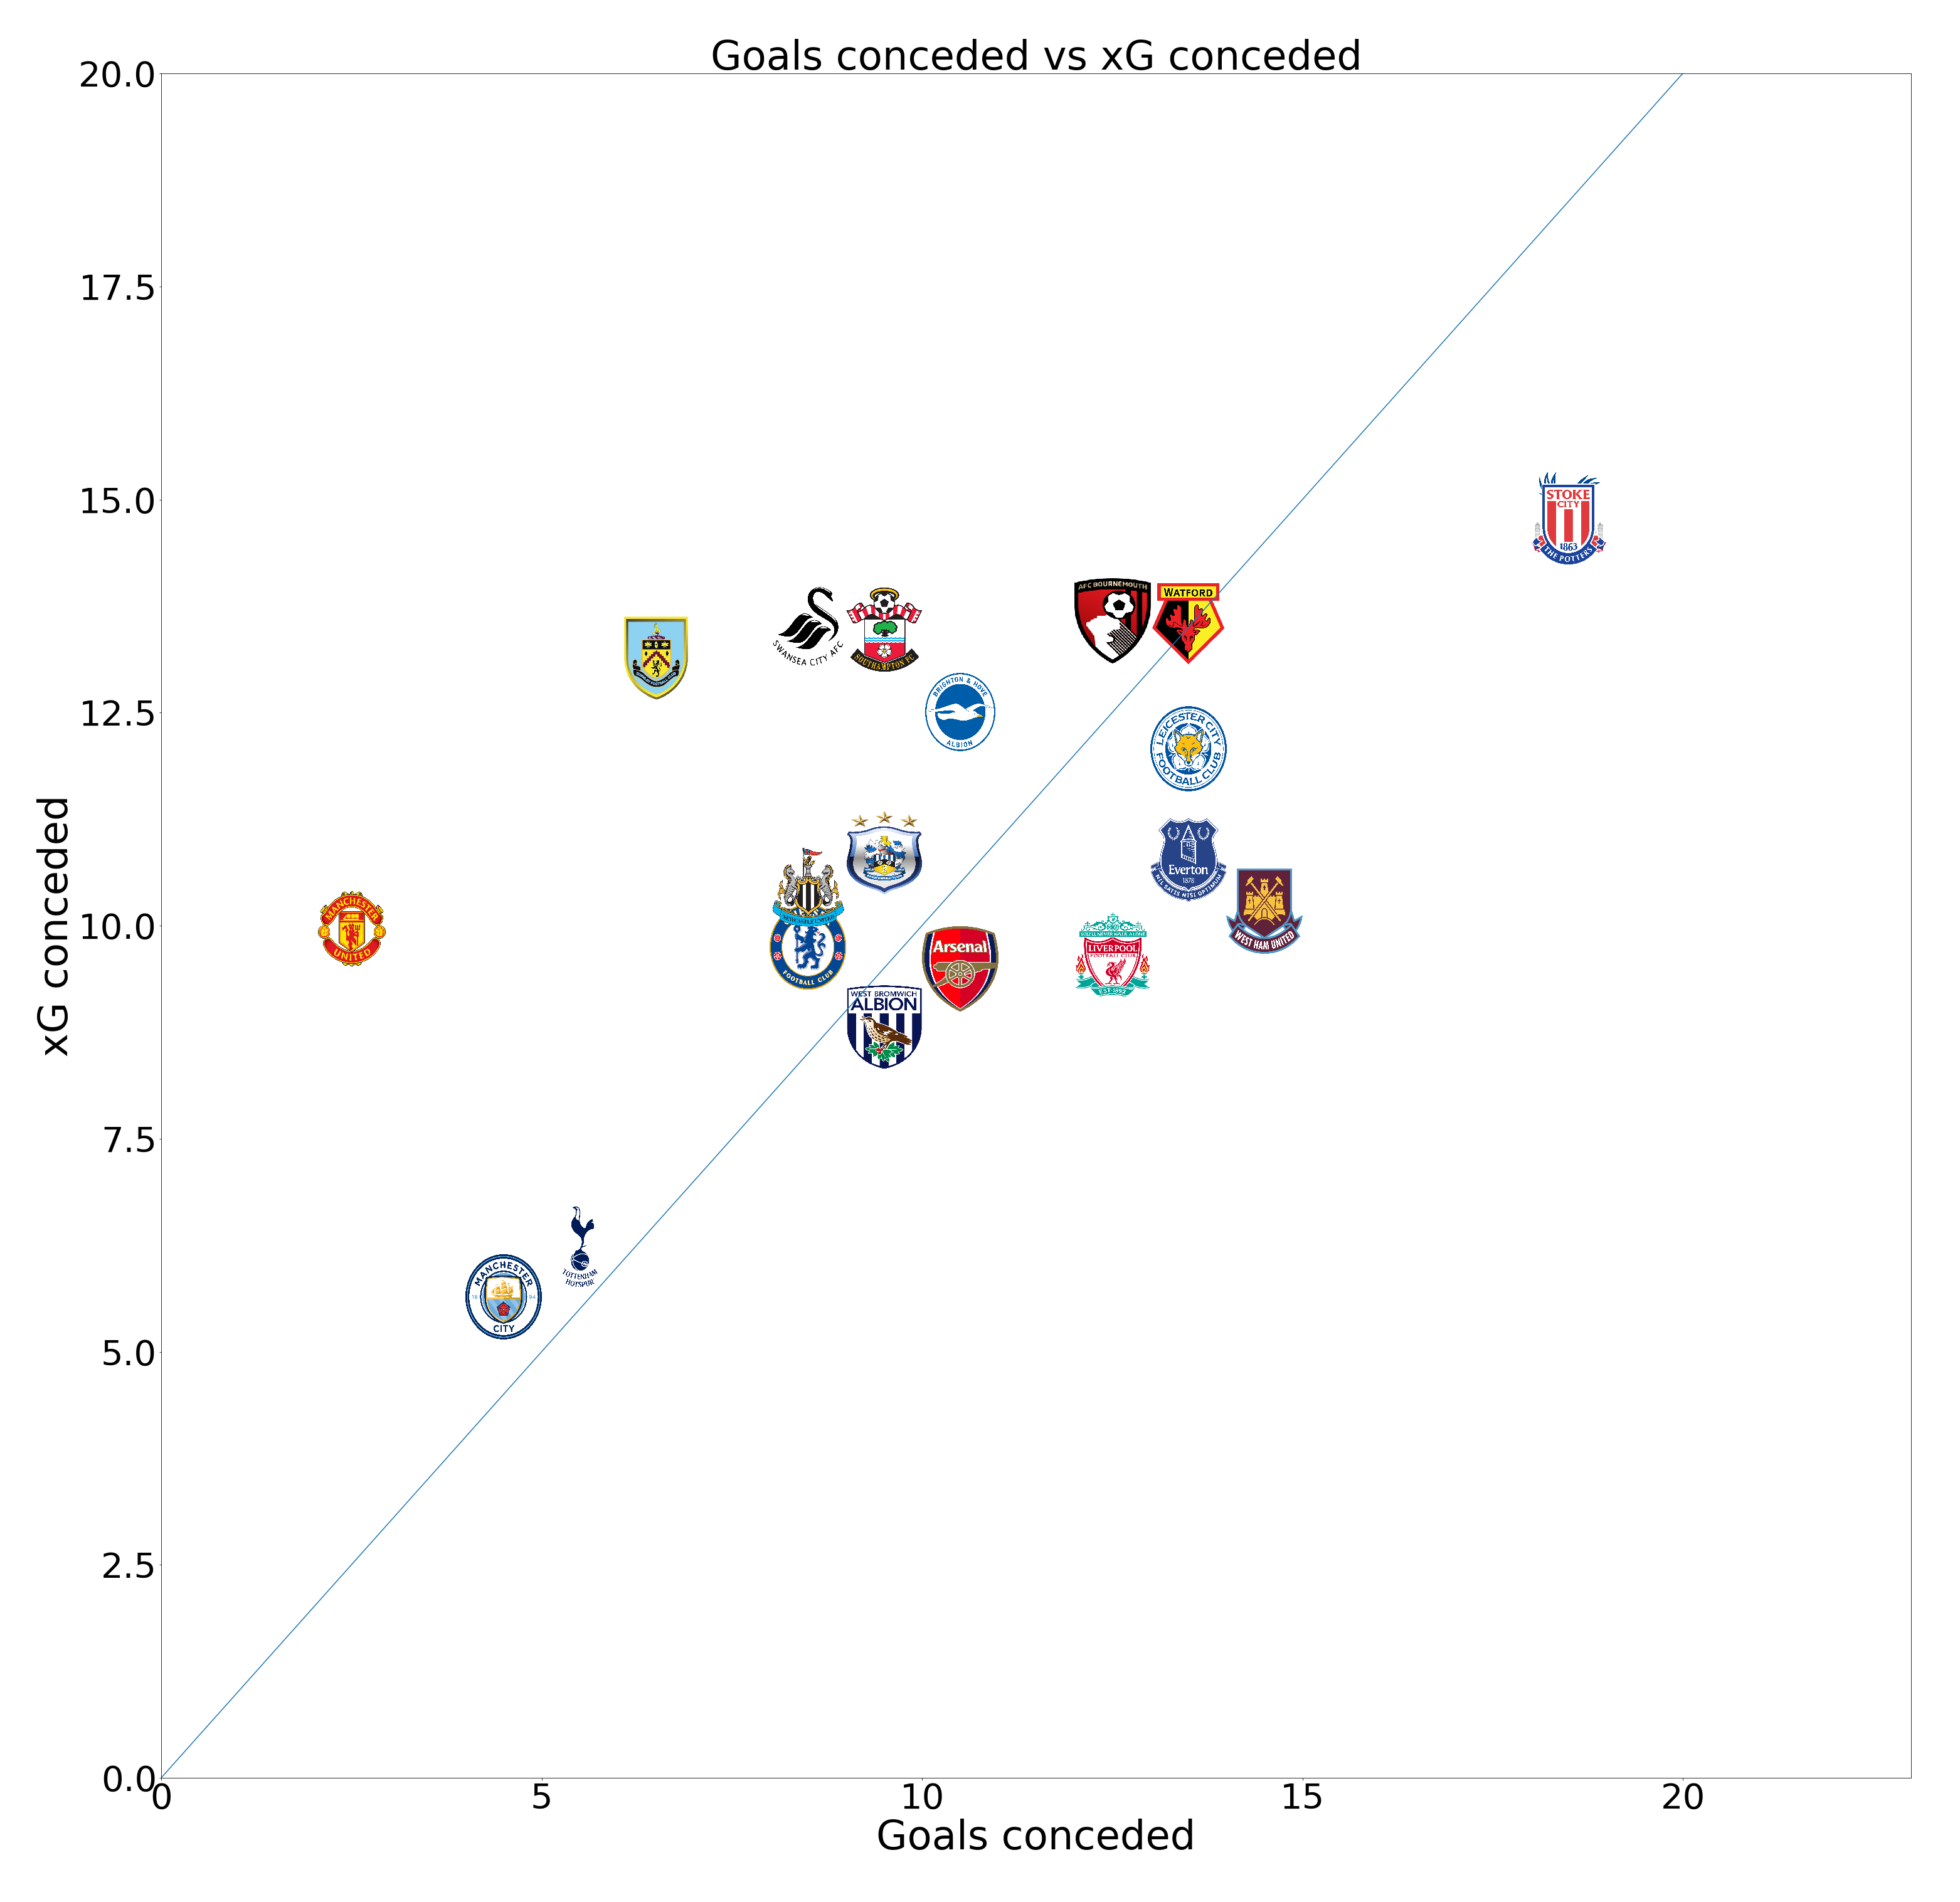
Current xG/ goals values
Unlucky
Lucky
Lucky
Unlucky

Slide 18
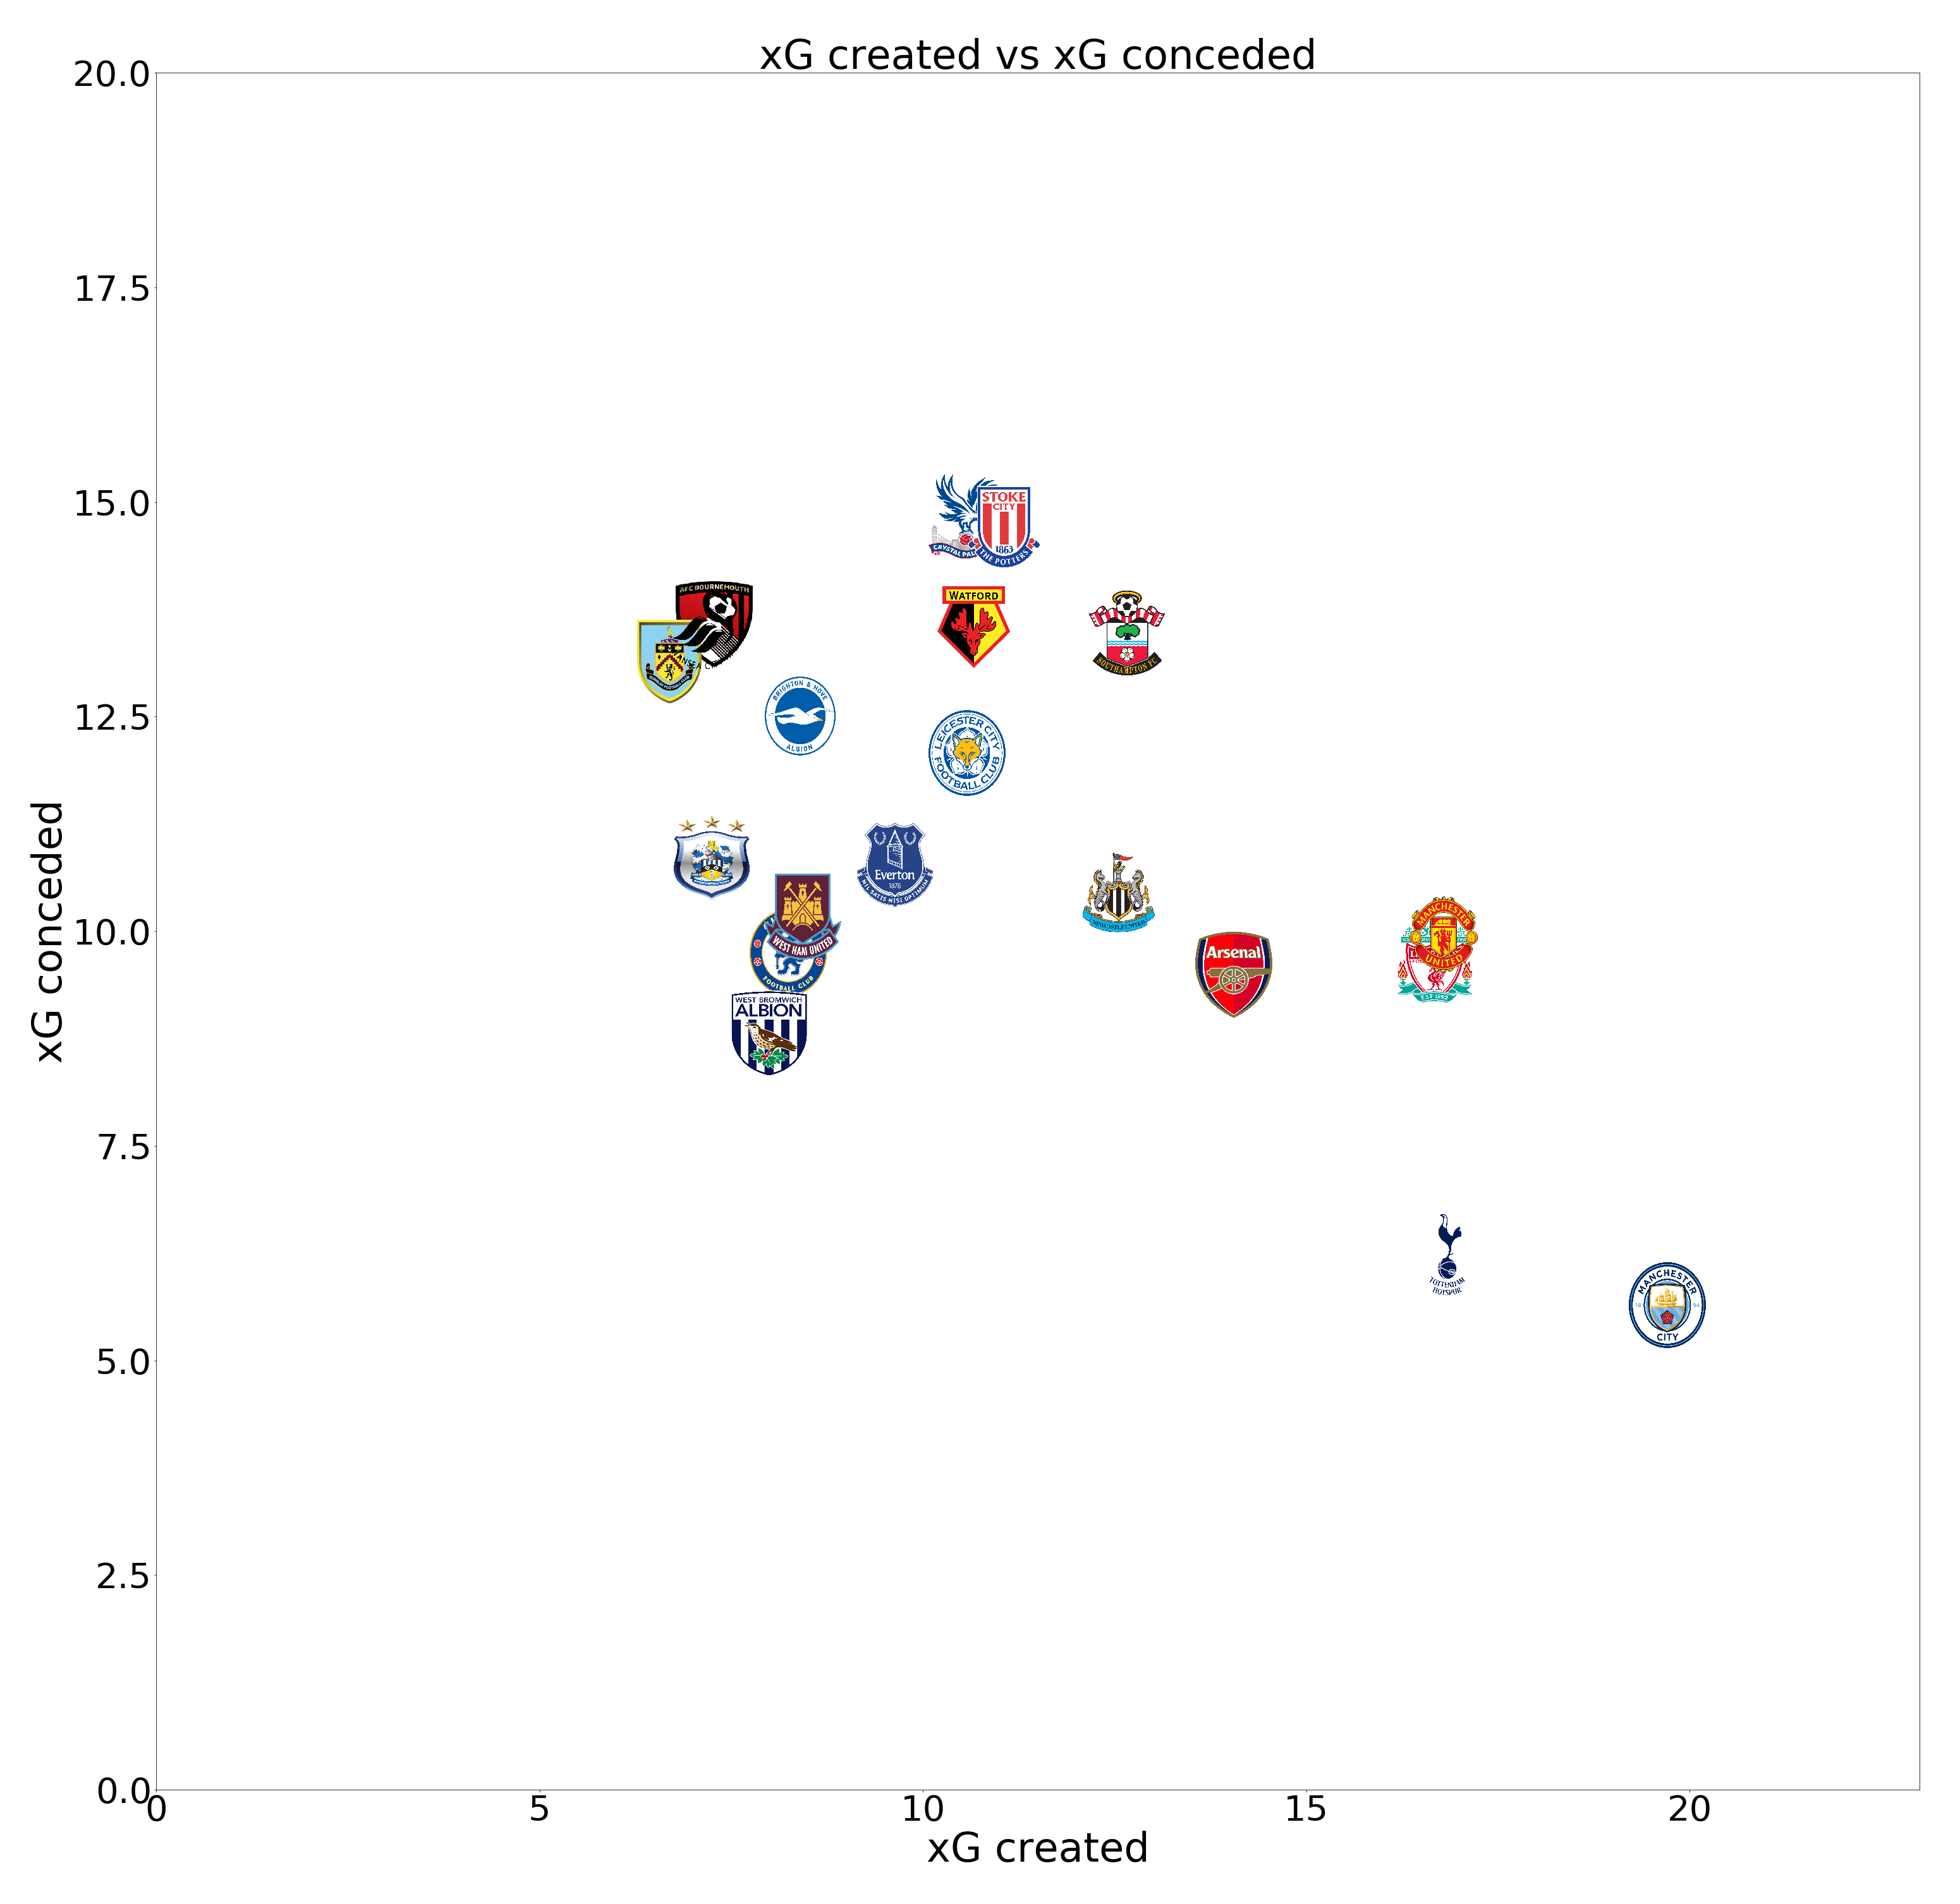
Current xG/ goals values

Slide 19
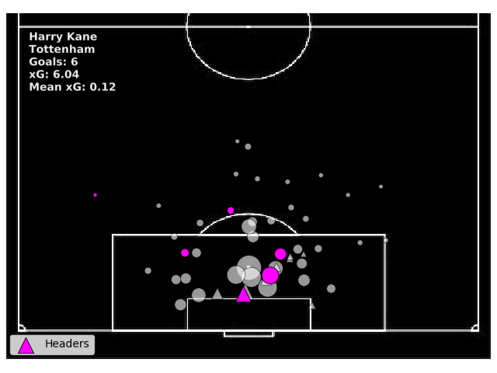
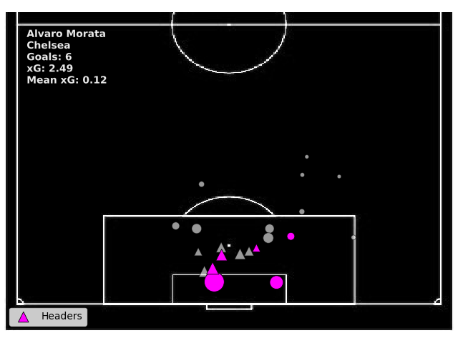
Top goal scorers so far

Slide 20
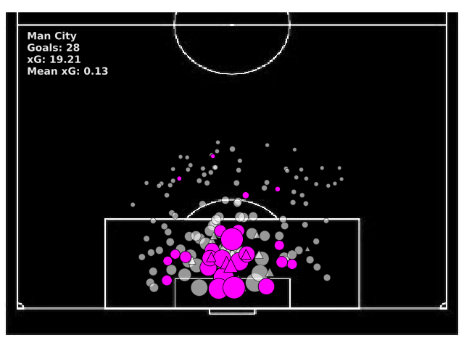
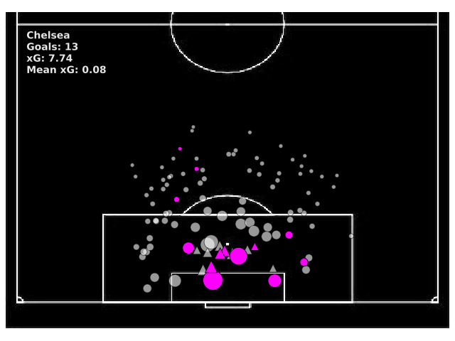
Teams
Notes:
Man City have had a goal go missing in the shot data!!

Slide 21
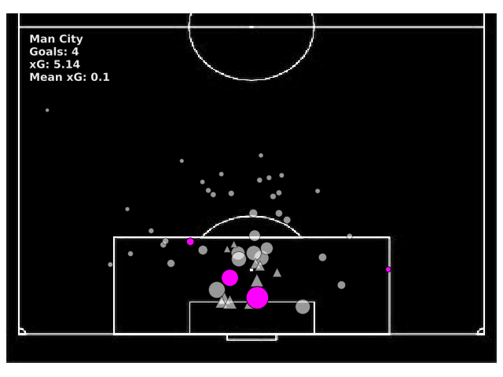
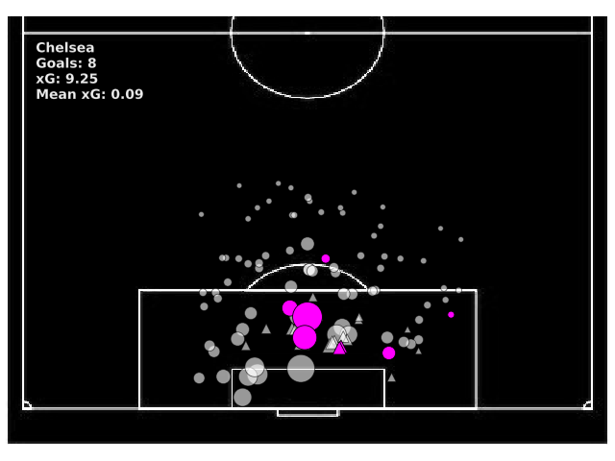
Teams

Slide 22
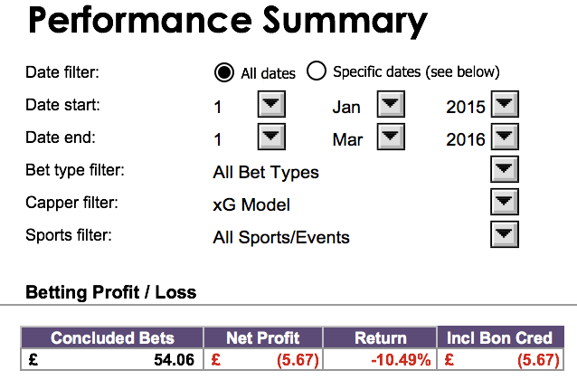
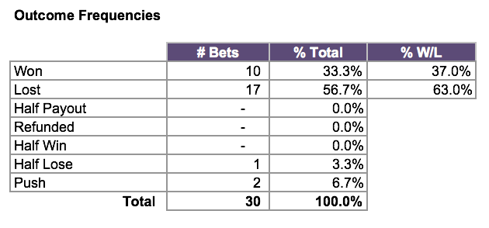
Betting game by game – end of GW8
Calculate the probability of a team winning using the bivariate Poisson
Notes:
Really good spreadsheet taken from an australian bookmakers
I have logged roughly £4500 worth of bets. ROI of 4.35%
Santander 123 account only gives you 1.5% interest!

Slide 23
Any questions
Or feedback/ tips?

